Slide 1
TEXT
Summarization
19102B0018_pradnyatayade
19102B0014_kiranjadhav
19102B0028_sumedhawachar
19104A0017_amulyakura

Slide 2
Introduction
Natural Language Processing (NLP) has a subfield called text summarization that works with extracting summaries from massive amounts of text.
NLP-based approaches and deep learning-based techniques are the two primary categories of text summarizing techniques.
We'll see a straightforward NLP-based text summarizing method in this presentation. No machine learning libraries will be used here. To summaries a chunk of text, we will only utilize the NLTK (Natural Language Toolkit) library in Python.

Slide 3
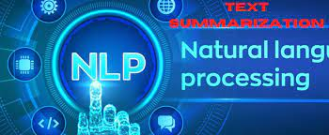
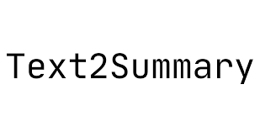
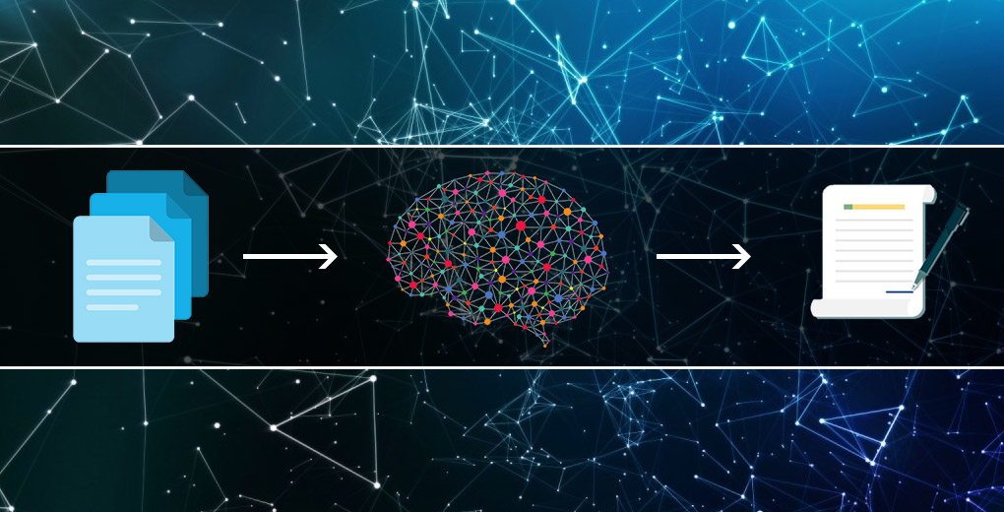
Objective
A text summarization system's main goal is to extract the most crucial information from a text and present it to the users.

Slide 4
Types of text summarization approach
Extractive
Abstractive
Select parts of the original text to form a summary
Restrictive (no paraphrasing)
Score words/sentences and pick
Generate new text using natural language generation techniques.
More flexible(more human)
Generate new texts

Slide 5
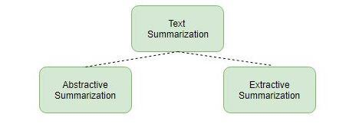
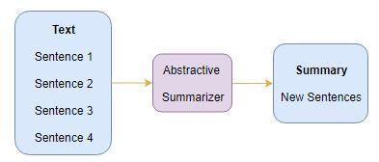
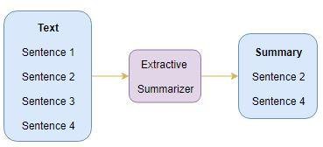
Work flow of both the approach

Slide 6
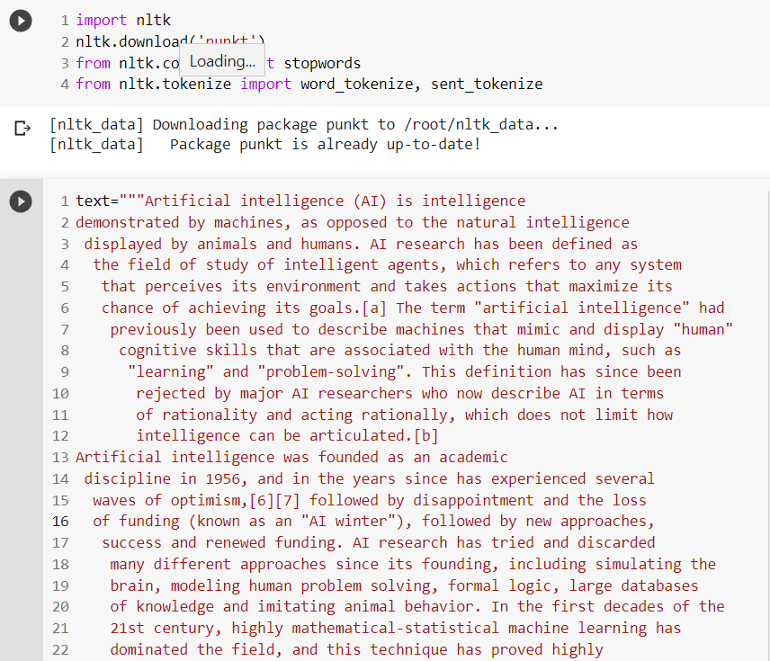
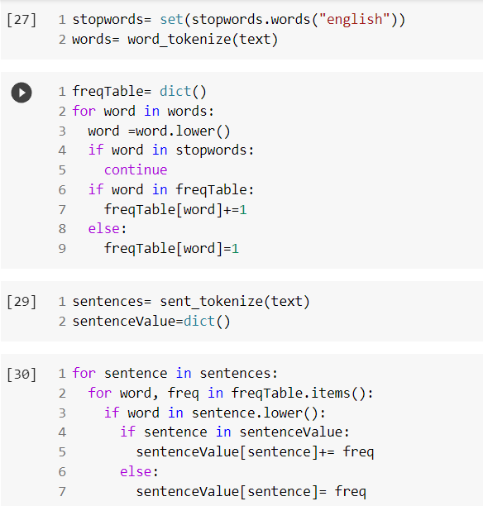
Code

Slide 7
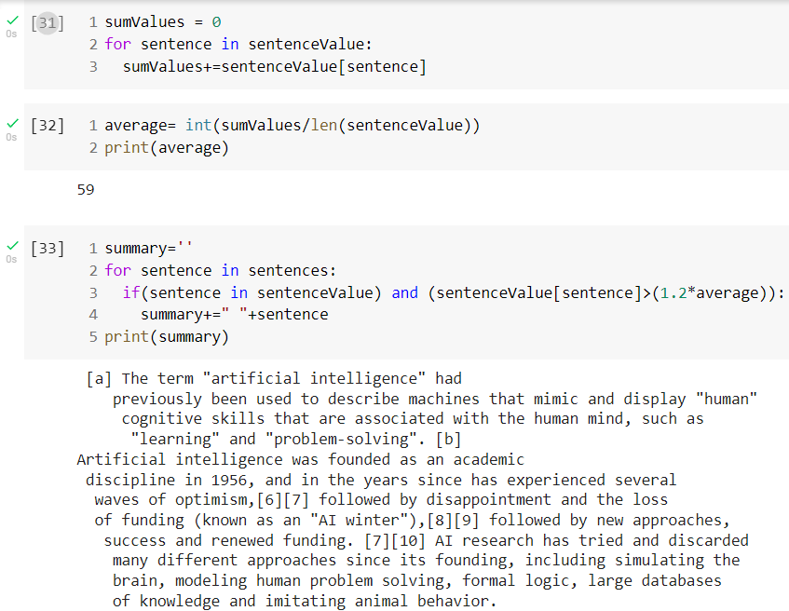
Code and result
GitHub link: https://github.com/PradnyaTayade/NLP/blob/9e393559c14c0e4c1bed1da9f8686e35c53f4db4/NLP_TEXT_summarization.ipynb

Slide 8
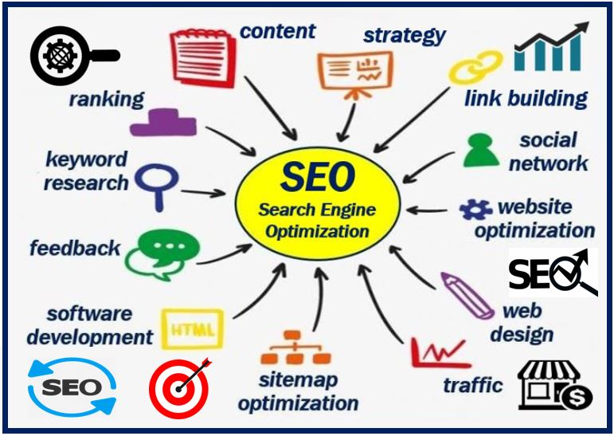


Applications
RNA
Mitochondria
Inshort news app
YouTube comment summarizer
Search marketing and SEO
The above and many more are some instances where summarization can be put to use in the business

Slide 9
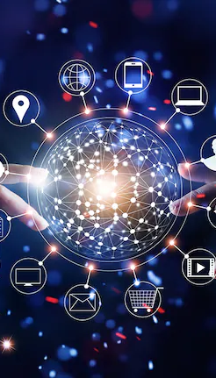
Conclusion and future work
Although text summarization is a tried-and-true problem, the current research focus is on new developments in the fields of biomedicine, product reviews, education, emails, and blogs. This is a result of the information overload in these areas, particularly on the Internet.
Research has been done on both abstractive and extractive techniques. The majority of summarization techniques rely on extractive techniques.
The abstractive method is comparable to human summaries. Currently, abstractive summarization is difficult to replicate in domain-specific settings and requires expensive machinery for language generation.

Slide 10
Thank you

